Slide 1
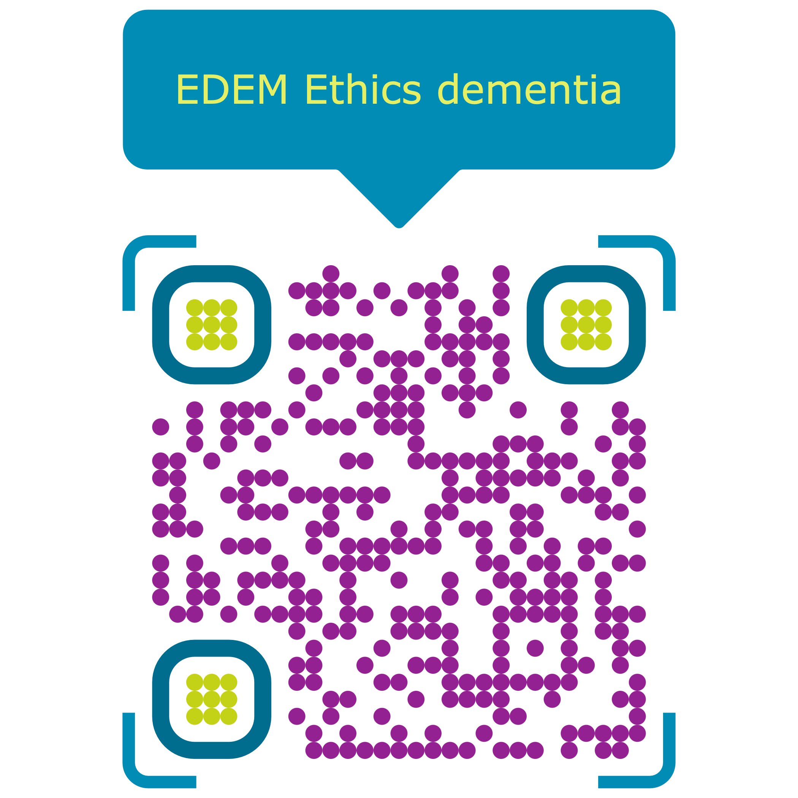
The main aim of the Ethics in Dementia (EDEM) Action is to promote ethical dementia care beyond the current state of affairs.
EDEM will work
to promote dignity, autonomy, and quality of life for people with dementia;
to reduce burnout and moral distress among formal and informal caregivers for people with dementia, and
to improve the quality and homogeneity of dementia care across Europe, by fostering international collaboration in the field of dementia and ethics, including CEECs.

