Slide 1
Ethics in Dementia
COST-project

Slide 4
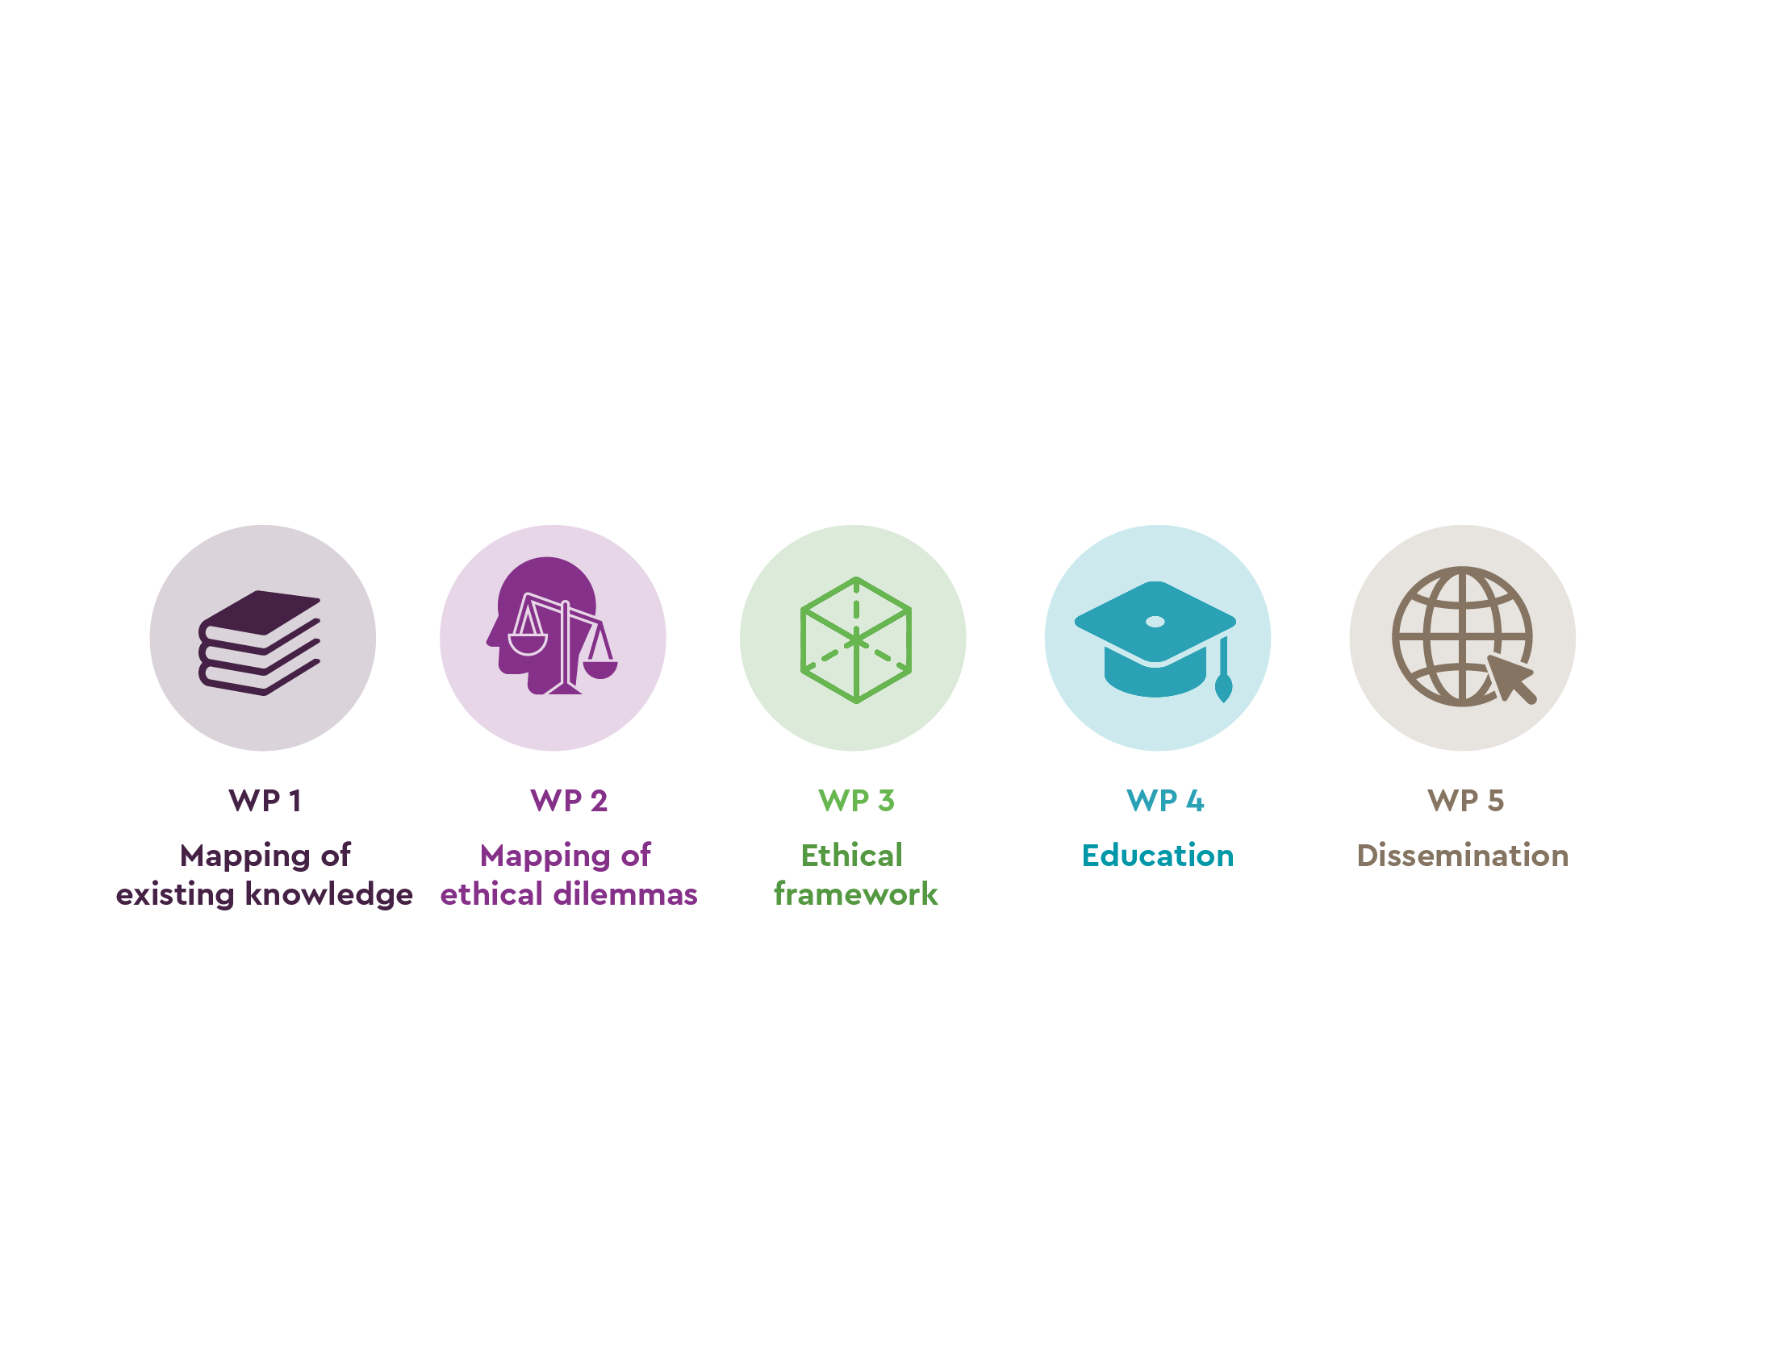

Slide 17
Dgmd,fmgdfsg
Dfgdfsgsdfgsdfg
Dsfgdfsgdsfg
Dfgdfsgdfsgdfsgdsfgdfgdfg
dfgdfsgdfg

